Slide 1

Data Collection, Cleaning and EDA

Slide 2
About me :
Name : Pawar Sonam
Batch : 346
Experience : Information Technology Senior Associate in Mainframe Technology
Graduation : Electrical and Electronics Engineering(Bachelor of Technology)
Gained exposure to Power BI and SQL during training, which sparked a strong interest in pursuing a career in Data Science.
LinkedIn : http://www.linkedin.com/in/sonam-pawar-029345211
Github : https://github.com/Sonam83

Slide 3
Business Problem :
1)Used cars analysis on Area wise and all over India
2) Brand wise used cars Analysis
Domain : Second Hand Cars(Buy used cars)
Objective : Conducted an analysis of second-hand car sales, both regionally and across India, with a focus on brand-specific trends.
Website : Cars24
Website link : https://www.cars24.com/
Target Feature : Location, Buy used car, Car overview
Summary :
Collected city-specific data using city IDs, extracted individual car links, and utilized regular expressions to retrieve the necessary columns. Constructed a DataFrame, exported the data to CSV format, and imported the file for further analysis, cleaned the data, performed Univariate, Bivariate/Multivariate analysis and created visualizations.

Slide 4
Exploratory Data Analysis :
Data Cleaning Steps :
- Converted improper to proper datatype
- Replaced special characters with space
- Changed irrelevant column names to appropriate format using rename
- Checked with duplicate records
- Numeric null values filled with mean or median
- Categorical null values filled with mode
- Dropped invalid columns
- Splitted the columns
- Treated missing values

Slide 5
b)Data Manipulation Steps:
- Utilised relevant libraries like requests, BeautifulSoup, Numpy, Pandas, Matplotlib, Seaborn and plotly
- Numeric null values treated with mean or median
- Categorical null values filled with mode
- As per requirement, Area and Brand has no outliers
- Set the maximum column and row width to display huge records
- Manipulated columns based on Area, Brand, Model year and Register year
- Car overview details are splitted into separate columns as Transmission, Fuel, Km Driven, Engine capacity , Month
and Registered Year

Slide 6
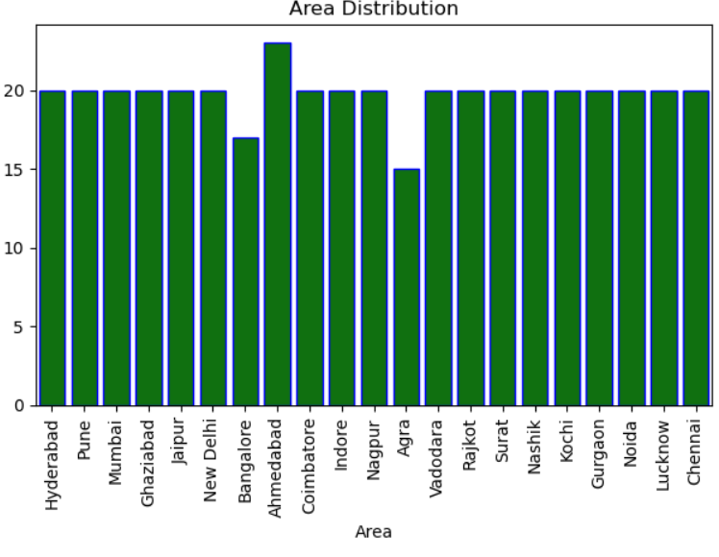
c) Univariate Analysis :
- Performed individual column analysis based on target features using relevant graphs for different data
types
- Almost all the car brands except Ahmedabad, Agra and Bangalore have same demand of purchase
- Count plot is used to know the number of purchase of cars in respective area, interpreted Ahmedabad has
highest purchase

Slide 7
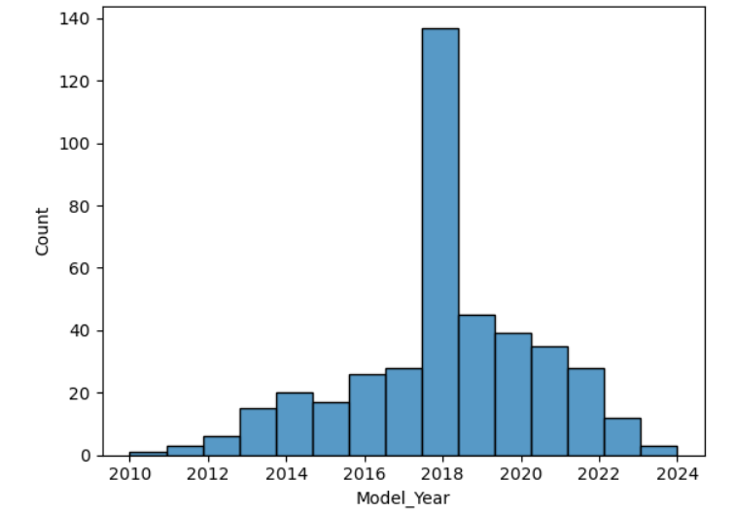
- Preferred hist plot for numerical datatype model year to know the count of cars purchased in a year and
observed
- 2018 has highest number of purchase, later trend diminished till 2024
- 2010 model cars has least demand , then increases and reaches zenith in 2018

Slide 8
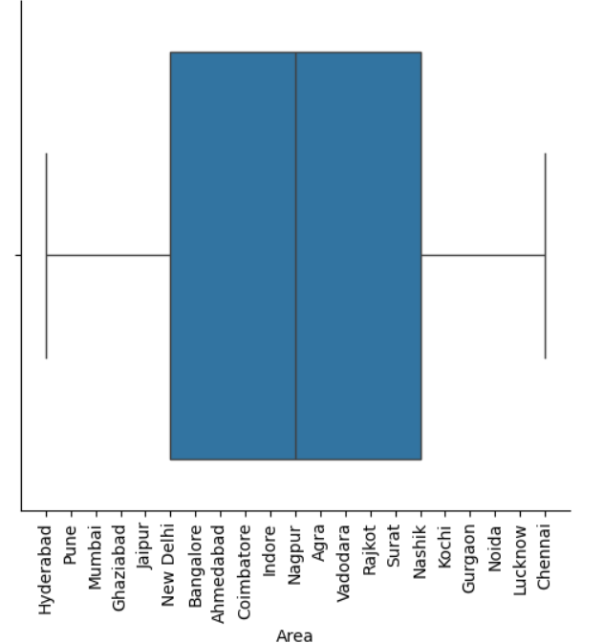
- Using whiskers, Interquartile range, upper bound and lower bound determined the outliers existence to all columns with respect to brand and area
- Categorical column of Area is plotted using cat plot of box kind to trace the outliers and interpreted no outliers

Slide 9
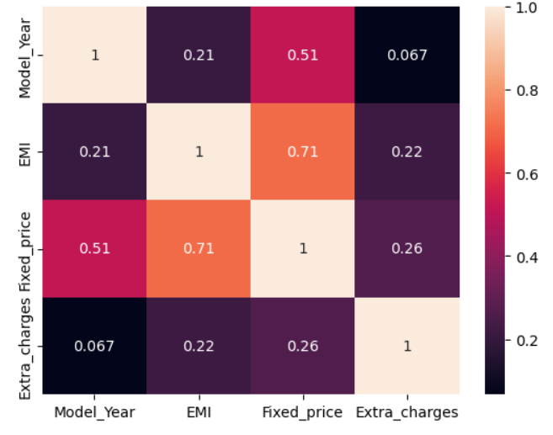
d) Bivariate Analysis :
- Three types of combinations have been used for bivariate or multivariate analysis
i) Continuous and Categorical Variable
ii) Continuous and Continuous Variable
iii) Categorical to Categorical Variable
- Heatmap is used for the analysis of continuous to continuous variable correlation and found only positive
correlation of variables exists, no negative correlation

Slide 10
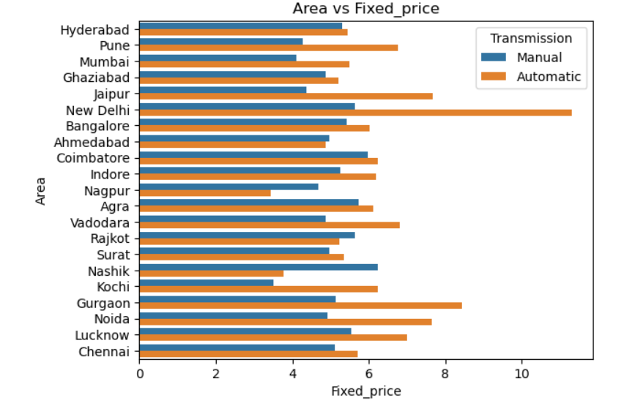
- To analyse the categorical to categorical variable relation, crosstab has been used with targeting features brand and area
- Area vs Fixed price relation is shown using bar plot

Slide 11
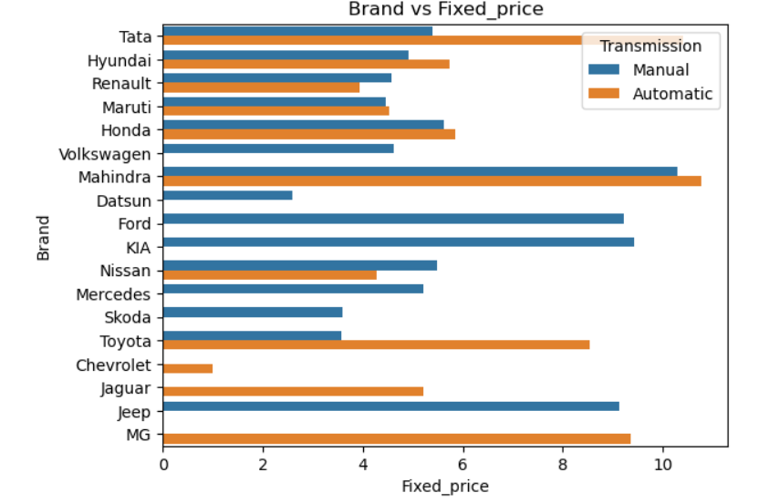
Brand vs Fixed price relation is shown using bar plot
Mahindra Brand of Automatic Transmission has 10L fixed price
Ford, Datsun, KIA, Skoda, Mercedes, Jeep don't have Automatic Transmission system
Chevrolet, MG, Jaguar brand has no manual transmission system based on fixed price

Slide 12
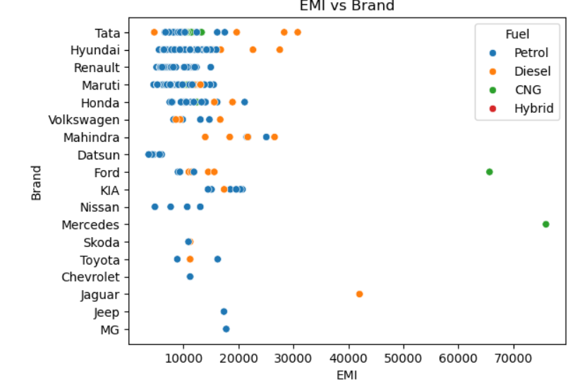
-Brand vs EMI relation depicted by using group by and scatterplot
-Petrol cars are selected than other fuel type cars
-Highest avg EMI for petrol fuel is 23000 per month
-Hyundai Brand is opted more having EMI less than 20000 per month
-Least EMI is available for Datsun Brand

Slide 13
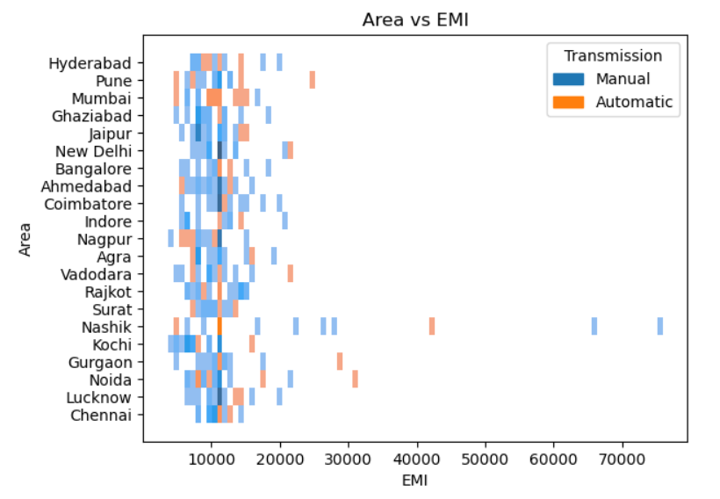
- Area vs EMI linkage is determined on the basis of using group by and hist plot
-Nashik has highest EMI monthly and its for Manual Transmission
-Mumbai has highest number of Automatic car preferences on comparing with EMI cost

Slide 14
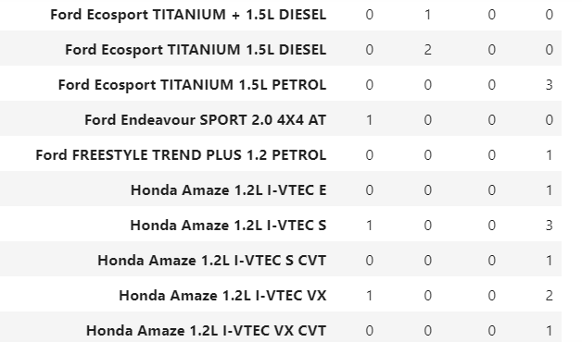
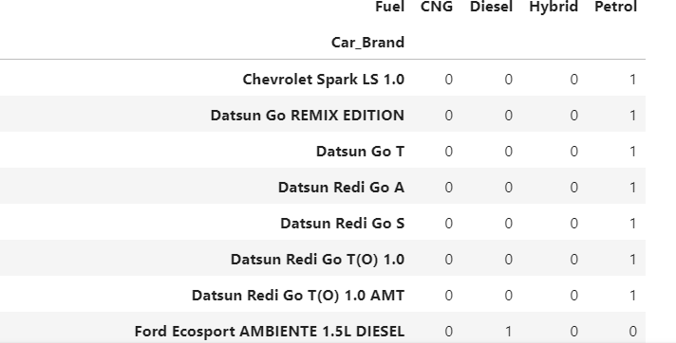
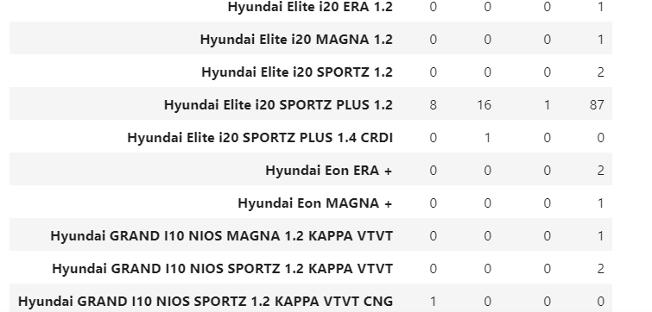
- To analyse the categorical to categorical variable relation, crosstab has been used with targeting features brand and area

Slide 15
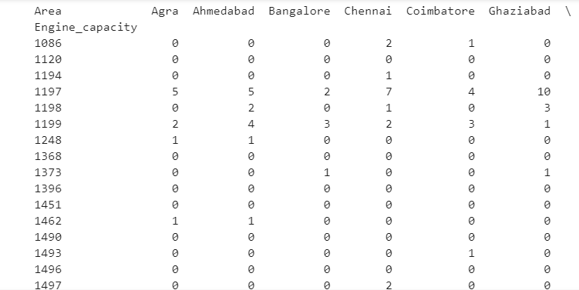
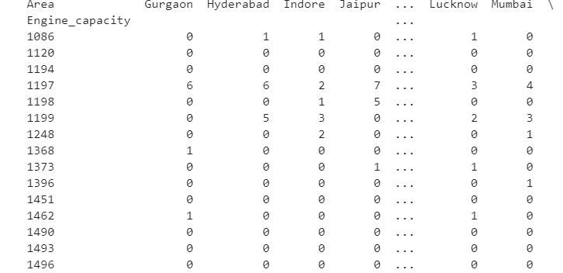
- Similarly, pivot table is utilised for the analysis of area, brand and engine capacity

Slide 16
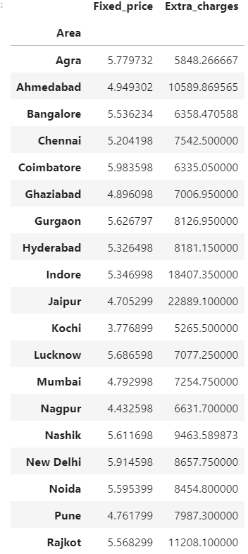
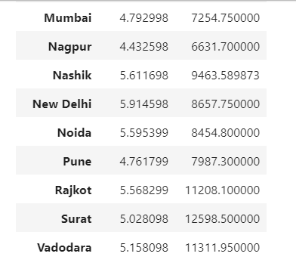
Area wise fixed price and extra charges were preferred for analysis using group by
Coimbatore has highest fixed price than other places
- Heavy extra charges were imposed more on Jaipur

Slide 17
Overall analysis in India :
Area wise and Brand wise data is grouped and analysed based on fixed price and extra charges
Throughout India an average fixed price of second hand car is 5.21 Lakh
Based on area and car overview, the demand of brand preference is altering
Extra charges are determined based on the transmission, fuel preferred and Engine capacity
Individual regional brands can be compared with overall statistics of India
There exists difference in Model year of the brand and registered year based on Engine capacity

Slide 18
Key Business Questions :
Which region has highest monthly EMI and what type of transmission is it?
How is the demand of purchase with respect to regions?
Which region has highest purchase ?
What is the trend of purchase from 2010 to 2024?
Which brand has highest price and what type of transmission is it?
How many brands are having only automatic transmission and manual transmission?
Which area has observed the highest Engine capacity?
Is there any variation of preference based on fixed charges ?
Which brand has highest price and least price in an area?
Which brand has driven maximum kilometers?
Does every brand of car has all types of transmission availability?

Slide 19
Conclusion:
Demand of Manual cars getting lower due to Automatic cars
Automatic cars preferred more in New Delhi among all given areas
Ahmedabad, Nagpur, Nashik areas demand for Manual cars over automatic cars
Average fixed price for Automatic cars lies between 5 to 7 lakhs
Average fixed price for Manual cars lies 4-5 lakhs
Highest average fixed price for automatic cars in New Delhi
Least average manual fixed price is in kochi
Ford, Datsun, KIA, Skoda, Mercedes, Jeep don't have Automatic Transmission system
Chevrolet, MG, Jaguar brand has no manual transmission system

Slide 20
Experience :
Initially, web scraping has given mismatched data format – so changed tag and class
Only fetched one city data due to empty list created inside –corrected by placing outside the loop
Unable to convert HTML to text-corrected by placing if else condition on appending nan values
Complete data is obtained on using set option
Splitted the data into numerous columns for ease extraction
Type Error is handled by converting particular column into string
Null values dealt with relevant data type conversion and filling with appropriate values
During visualizations, warning is resolved on using error bar=None

Slide 21
Questions, if any ?

Slide 22

THANK YOU

